Slide 1
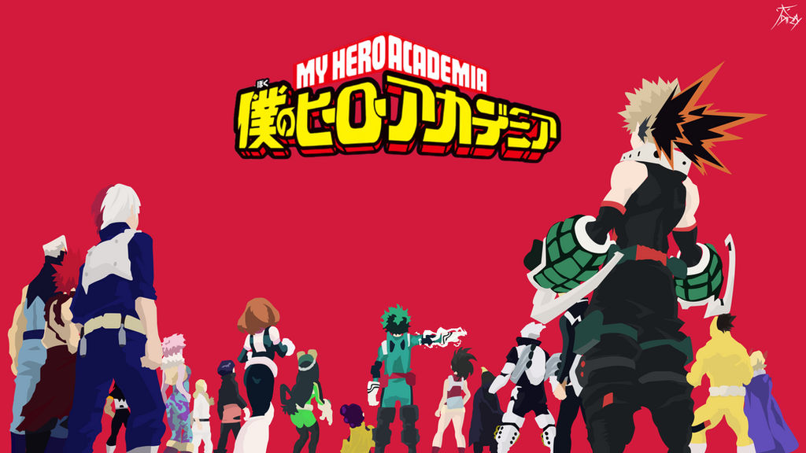

Fandoms in MHA
Alex Kimball
Jacky Irwin
Tessa Price

Slide 2

Background and Motivation

Slide 3
Intro
Fandoms:
Universe created by someone that is followed by others
Fanfics:
Spin offs written by fans
Ships/Shipping:
Pairings of characters that the fans would like to see.

Slide 4

Background and Motivation

Slide 5


The Primary Questions
Character with the most number of ships?
Characters most discussed?
Highest number of Hits?
Correlation between Characters, Ships and hits?

Slide 6
Want to Learn
Discernible patterns
Analyzing the patterns if any for future benefit

Slide 7

Benefits
Improving stories
Correct audience
More enjoyable

Slide 8

DATA

